Slide 1
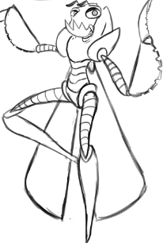
Unity Game Test Plan
Team members: Anthony Jamora, Thomas Burke, Jonathan Nabors

Slide 2

Unity Test Tools
Integration Test Framework
Automate
Assertion Component
Help Debug
Combo with Integration Test Framework
Unit Test Runner
Nunit Framework
Within Editor

Slide 3
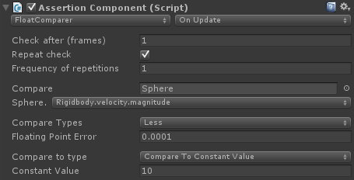
Unity Assertion Component
Within editor
Script Component
Pause with console
What to compare
When to compare

Slide 4

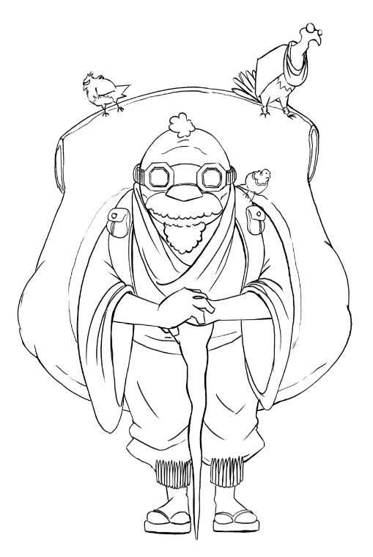
Unity Integration Test
Within Editor
Separate Scene
Multiple test per scene
Test Game Object
Common & Non-common Game Objects

Slide 5
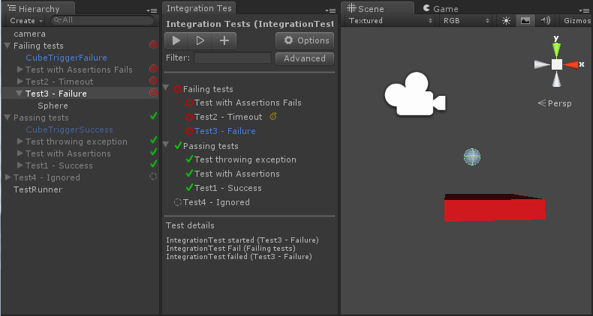

Slide 6

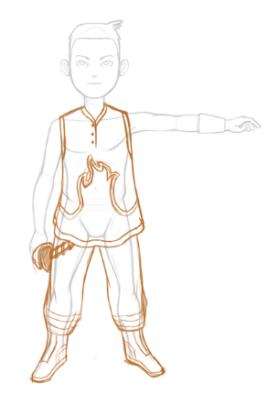
Compatibility Testing
Minimum requirements
What Needs to be Tested?
Game Installation
Game Execution

Slide 7
Compatibility Test Example
ID | CT_1
Item to Test | Game Installation
Pre-Conditions | All files required for game installation are present on the user’s machine User must have the Windows 7 or Windows 8 Operating System installed on their machine
Test Steps | Repeat the below process for both Windows 7 and Windows 8 personal computers: Locate game installer package Unity_Game.msi Double click the installer package Unity_Game.msi Choose the installation destination on the PC Follow the steps presented in the installer until completion Click the Finish button at the end of the installation steps
Expected Results | The installation package has created the game folder at the specified location via the installer package. In this game folder is the Unity_Game.exe executable file to launch the game application.
Priority | High
Pass/Fail | If any error happens during the installation, it is considered a failure. If the game is successfully installed to the machine, it is considered to have passed.
Risks
Pass/Fail Criteria
Enviornmental Needs
Entry/Exit Criteria
Suspension/Resumption Critera

Slide 8
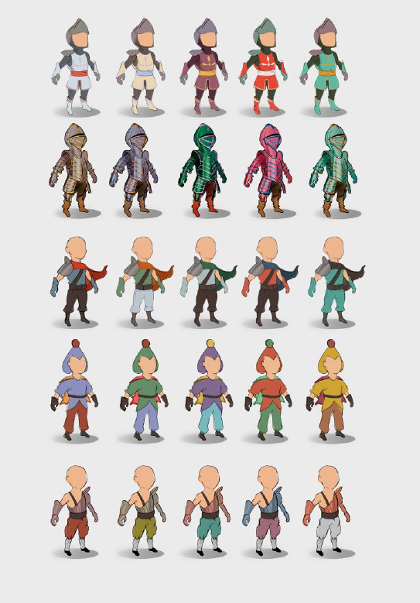
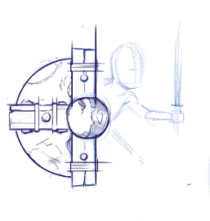
Functional Testing
Corresponds with functional requirements
Tools
Unity Integration Test Framework
Unity Assertion Component
Total of 33 tests

Slide 9
Functional Test Example
ID | FT_2
Item to Test | Options Screen
Pre-Conditions | CT_1, CT_2, and FT_1 must be successful. The game must be running and the game player must be at the Main Menu
Test Steps | Execute OptionsPress() function from the MainMenu scene. This is a part of FT_1. Execute BackPress() function from the optionsCanvas Back Button script component Read resulting output in console window to determine pass/fail.
Expected Results | Options menu shall enable then disable. Return to console window with results.
Priority | High
Pass/Fail | Return message from Expected Results will result in a pass. Any message formatted as [“_____” not found] will result in a fail.
Risks
Pass/Fail Criteria
Enviornmental Needs
Entry/Exit Criteria
Suspension/Resumption Critera

Slide 10

Performance Testing
Tools
Unity Integration Test Framework
Unity Assertion Component
Total of 6 performance tests
FPS Test
Item Load Benchmarks
Menu Response Times
Player/Enemy Reaction Times
Enviornment Reaction Times

Slide 11
Performance Test Example
ID | PT_1
Item to Test | Frames per Second Test
Pre-Conditions | CT_1, CT_2, FT_1, FT_8, and FT_10 must be successful. The game must be running and the game player has selected ‘New Game’ from the Main Menu.
Test Steps | Execute EnterGame() function from the MainMenu scene. This is a part of FT_8. Call Update() function from the TestFPS script each time the screen is updated. Test if variable ‘currentFPS’ ever drops below 20.
Expected Results | No output to console window
Priority | Medium
Pass/Fail | If the console window returns “Frames below threshold” the test is considered to have failed. Else it is a pass if the console window is blank.
Risks
Pass/Fail Criteria
Enviornmental Needs
Entry/Exit Criteria
Suspension/Resumption Critera

Slide 12
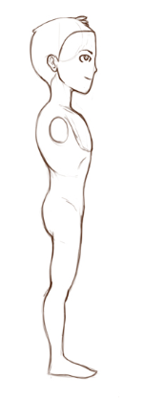

User Acceptance Testing
High-level Requirements
Presence of core game features
User Acceptance Tests
Menu
Friendly NPC
Enemy
Puzzle
Item Container

Slide 13
User Acceptance Test Example
ID | UAT_2
Item to Test | Friendly NPC
Pre-Conditions | Game build was executed Player started a New Game
Test Steps | Approach NPC Interact, Read dialogue for game information
Expected Results | Player is informed about their environment, and also that enemies are about to spawn
Priority | High
Pass/Fail | If the Player is able to read and complete the NPC’s dialogue, and if enemies spawn once finished, the test is considered passing.
Risks
Pass/Fail Criteria
Enviornmental Needs
Entry/Exit Criteria
Suspension/Resumption Critera

